Slide 1

Introduction to Robotics
2016 Fall

Slide 2
Project Roadmap
Date | Project | Finished?
9/06/16 | Introduction of Robot and Robotics, mBot Assembly | yes
9/13/16 | Introduction of mBlock | yes
9/20/16 | Play an Octave | yes
9/27/16 | Push a Button | yes
10/04/16 | Light Sensor, UltraSonic Sensor
10/11/16 | Drive with Remote, Line Following
10/18/16 | Robot Movement 1
10/25/16 | Robot Movement 2, Trace a Shape
11/01/16 | Obstacle Avoidance
11/08/16 | Sumo Wrestling 1
11/15/16 | Sumo Wrestling 1
11/22/16 | Maze 1
11/29/16 | Maze 2
12/06/16 | C Programming 1
12/13/16 | C Programming 2

Slide 3
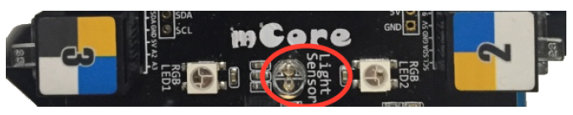
Project: Light Sensor
The mBot has a light level sensor on the top of the circuit board that can be used to measure the level of available light around the robot. This sensor can also be used to trigger the robot to perform an action when the light rises above or falls below a user-specified level. The light sensor measures light and returns a value in the range of 0 – 1024.

Slide 4
Light Sensor: Requirements
This program will act as a black-out alarm. The program shall:
1. Measure the available light.
2. Make a sound when the current light level drops 20% below the normal light level.
3. Turn off the sound when the light level rises above the low-light threshold.

Slide 5
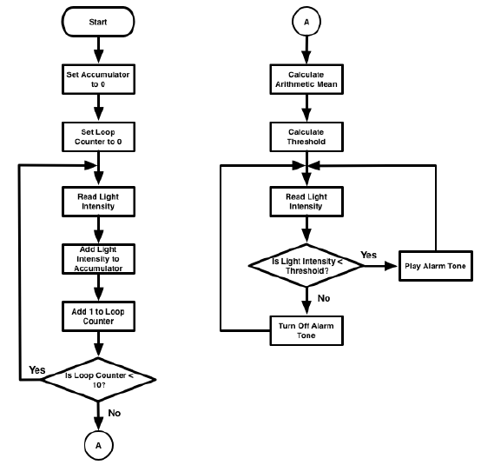
Light Sensor: Design

Slide 6
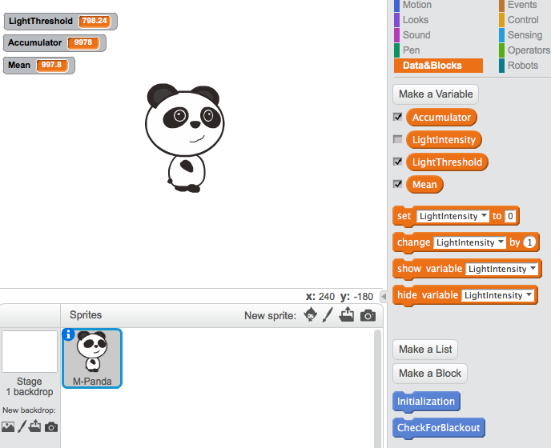
Light Sensor: Implementation 1

Slide 7
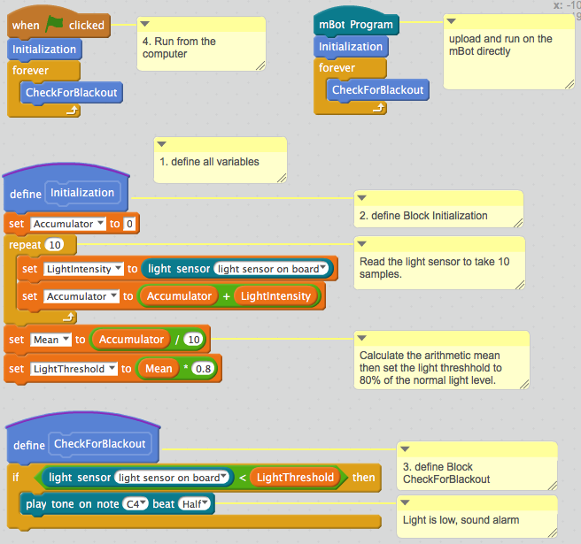
Light Sensor: Implementation 2

Slide 8
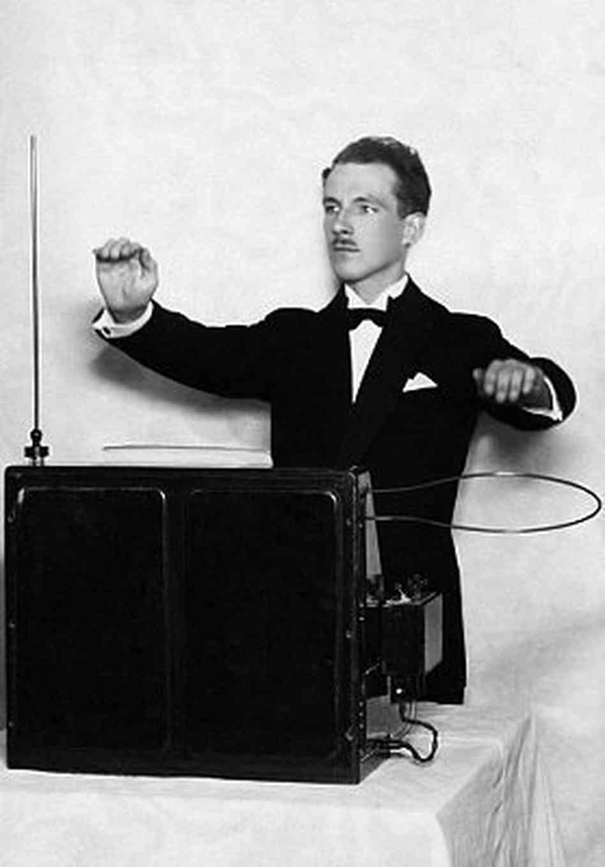
Project: Ultrasonic Theremin

Slide 9
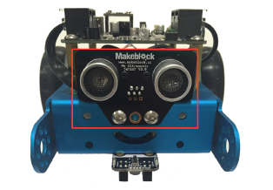
Project: Ultrasonic Theremin
The mBot has an ultrasonic sensor mounted on the front that looks like eyes . This sensor operates by sending out an ultrasonic signal from one of the eyes and receiving the reflection of the signal in the other eye . This signal is too high for humans to hear, but some animals, such as dogs, have hearing that is sensitive enough to hear some ultrasonic signals. When in operation, the ultrasonic sensor operates in the same fashion as the sonar (SOund NAvigation and Ranging) on a submarine or surface vessel.

Slide 10
Ultrasonic Theremin: Requirements
1. The robot shall begin playing a tone when it detects something within a range of 15-50cm.
2. The robot shall stop playing a tone if the object is less than 15 centimeters away or more than 50 centimeters away.
3. The robot shall play a maximum of one octave (8 notes, C D E F G A B C) based on an equal spacing over the 15-50cm range.

Slide 11
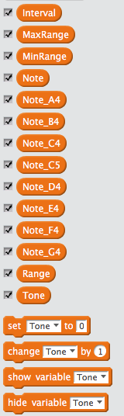
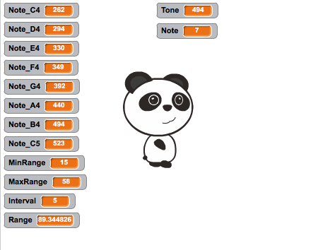
Ultrasonic Theremin: Implementation, define variables

Slide 12
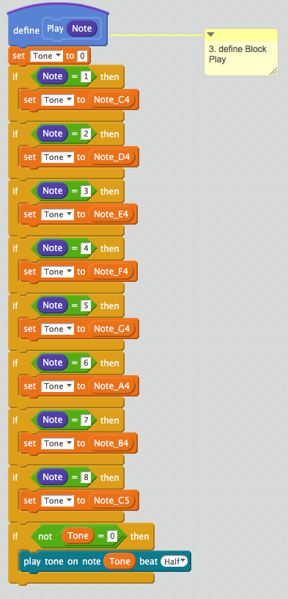
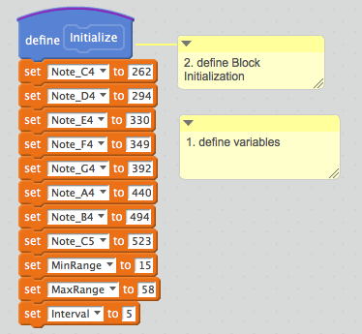
Ultrasonic Theremin: Implementation

Slide 13
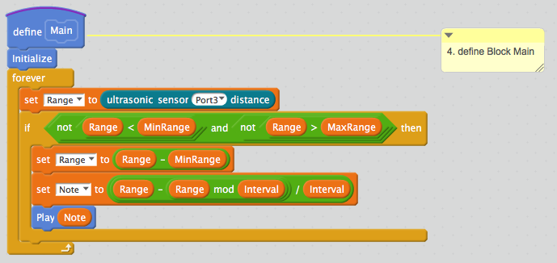

Ultrasonic Theremin: Implementation

Slide 14
